Slide 1
고유치 (eigenvalue) 계산 알고리즘 개론
Bumhee Cho

Slide 2
보통 사용하는 알고리즘: QR Algorithm
If A = QR with Q invertible, then A is similar to A₁ = RQ
R = Q⁻¹A
A₁ = Q⁻¹AQ
Q⁻¹ = Q^{T}
R = upper triangular
A = Q₁R₁
A₁ = R₁Q₁
A₁ = Q₂R₂
A₂ = R₂Q₂
⋯
A_{k} converges to a triangular matrix, Schur form (under certain conditions)
eigenvalues: diagonal entries of A_{k}
또 뭐가 있을까? Jacobi method (Jacobi rotation matrix)

Slide 3
컴퓨터로 어떻게 QR Decomposition을 하나?
선형대수학 강좌: Gram-Schmidt Process
최악의 선택, numerically unstable
Givens reduction
Householder method
좋은 참고 문헌 (chapter 2 & 11):
Numerical Recipes - The Art of Scientific Computing 3rd Ed. ,W. H. Press, et al. (2007)
2판은 온라인에서 무료로 볼수 있음! http://apps.nrbook.com/c/index.html

Slide 4
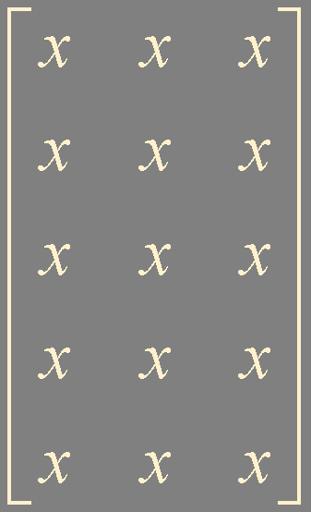
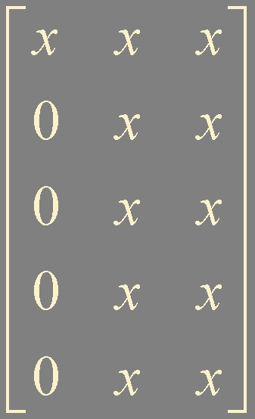
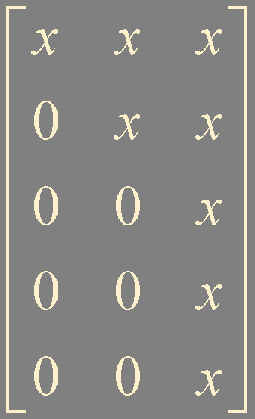
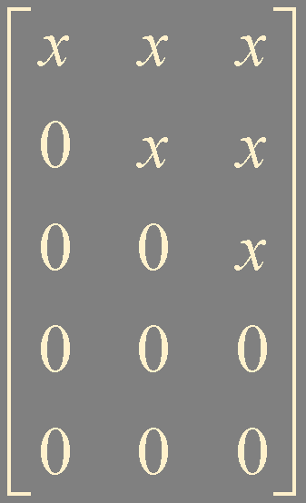
QR Decomposition by Householder Method
R
P₁
P₂
P₃
A
P₁A
P₂P₁A
P₃P₂P₁A
P₁ , P₂ , … : Householder reflector (matrix)
Q = P₁P₂P₃

Slide 5
Householder Reflector
P = I - 2uu^{T}
u: a unit vector
x ∈ ℝ^{n} , not zero vector
Px = x - 2uu^{T}x
= x - 2(x⋅u)u
proj_{u}x
= (x⋅u)u
x
P⁻¹ = P^{T} = P
P² = I
u
reflection across H
H
Px = x - 2(x⋅u)u
-2(x⋅u)u

Slide 6
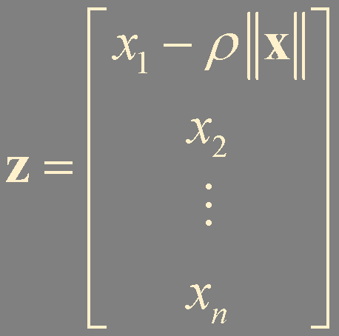
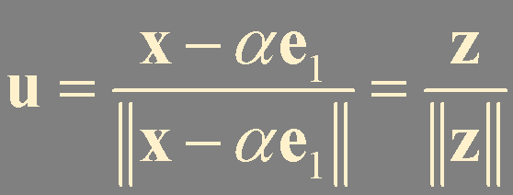
Householder Reflector for QR Decomposition
P = I - 2uu^{T}
x ∈ ℝ^{n} , not zero vector
ρ = ±1
α = ρ||x||
Px = αe₁
x를 어떻게 선택할까?

Slide 7
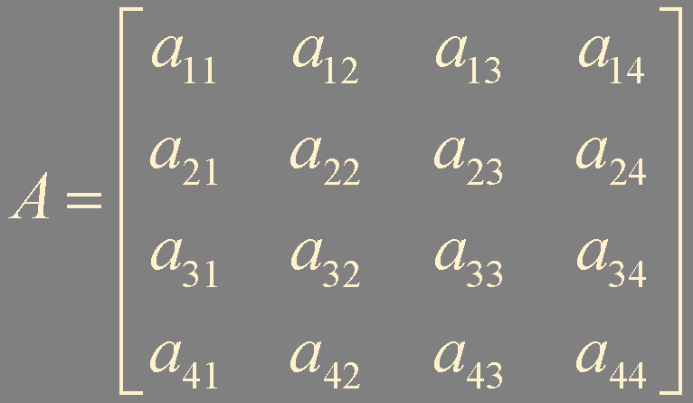
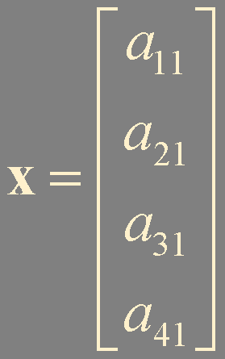

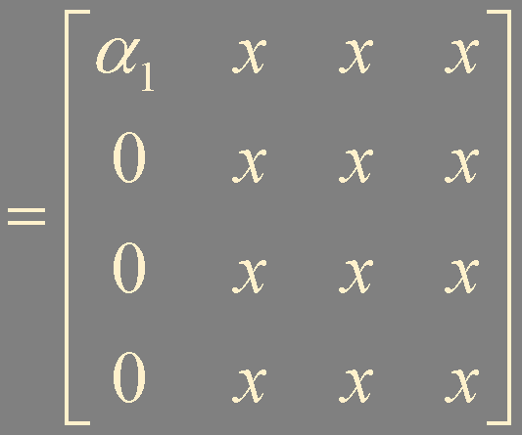
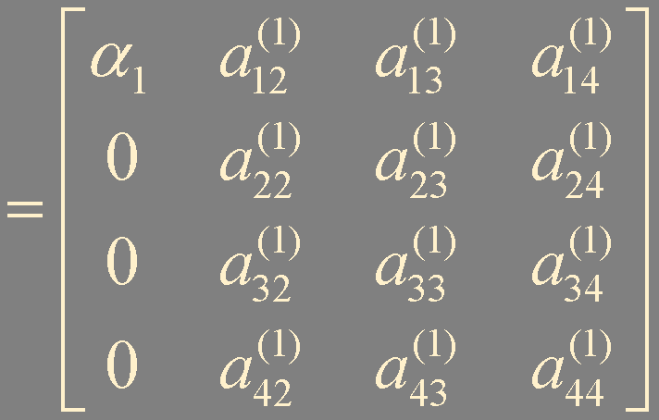
P₁ = I - 2u₁u₁^{T}
P₁x = α₁e₁
A₁₁
A₁₂
= [ α₁e₁ P₁A₁₂ ]
= A⁽¹⁾

Slide 8
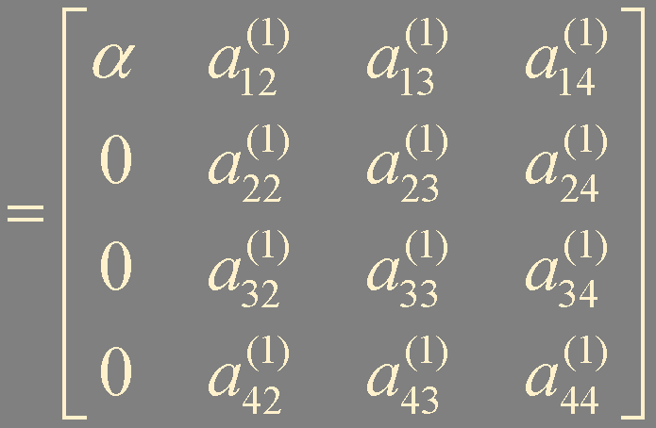
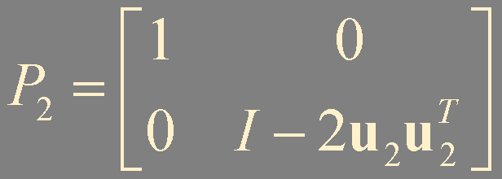
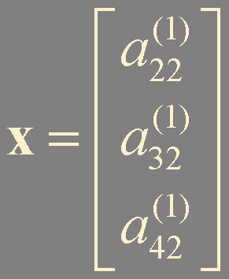
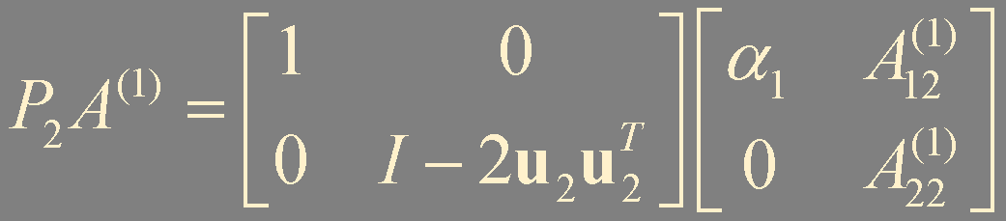
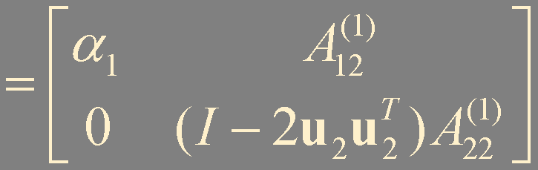
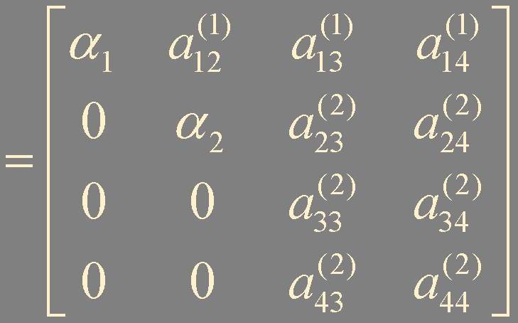
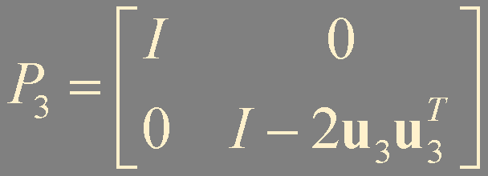
P₁A = A⁽¹⁾
반복...
P_{n-1}P_{n-2}⋯P₁A = R
Q = (P_{n-1}P_{n-2}⋯P₁)⁻¹ = P₁P₂⋯P_{n-1}

Slide 9
QR Algorithm 구분
One-step approach
기본 알고리즘을 그대로 사용
A = Q₁R₁
A₁ = R₁Q₁
A₁ = Q₂R₂
A₂ = R₂Q₂
⋯
한번의 QR decomposition의 work-load는 ~n³
보통 n번 이상의 반복이 필요 work-load > ~n⁴
이런 식으로는 안함

Slide 10
Two-Step approach
a) symmetric (Hermitian) matrix: all eigenvalues are real
1) Reduction to tridiagonal matrix: Householder ~n³
2) QR algorithm: QR decomposition per iteration ~n
+ shift method
b) non-symmetric matrix
수치적 에러는 주로 norm에 비례
1) Balancing: reduces matrix Euclidean norm ~n²
1) Reduction to upper Hessenberg matrix: Householder ~n³
2) QR algorithm: QR decomposition per iteration ~n²
+ shift method
Fundamentals of Matrix Computations, 2nd Ed., D. S. Watkins (2002)

Slide 11

Hessenberg Form by Householder Reduction
upper Hessenberg form
non-zero일 필요는 없다, zero여도 상관 없음
all-zero는 upper triangular matrix

Slide 12
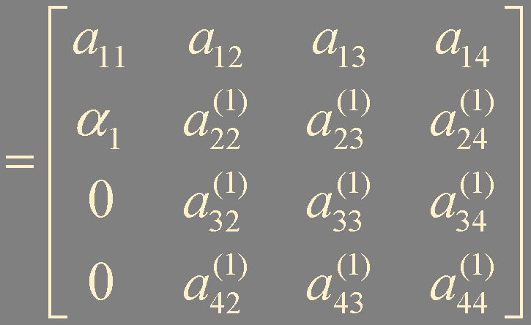
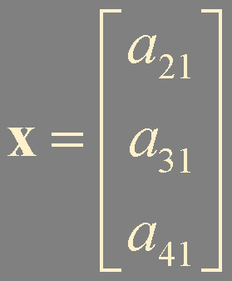
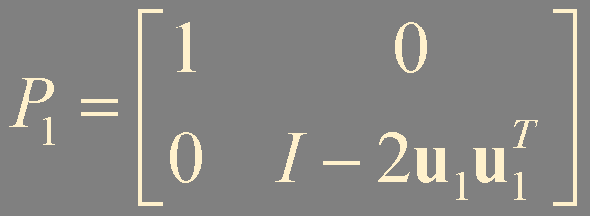
P₁ = I - 2u₁u₁^{T}
P₁A
P₁x = α₁e₁
P₁A
반복하면 Hessenberg form
혹은 tridiagonal form (symmetric / Hermitian)
similar to A
QR algorithm (decomposition by Givens or Householder)
-> eigenvalues = diagonal entries of A_{k}

Slide 13
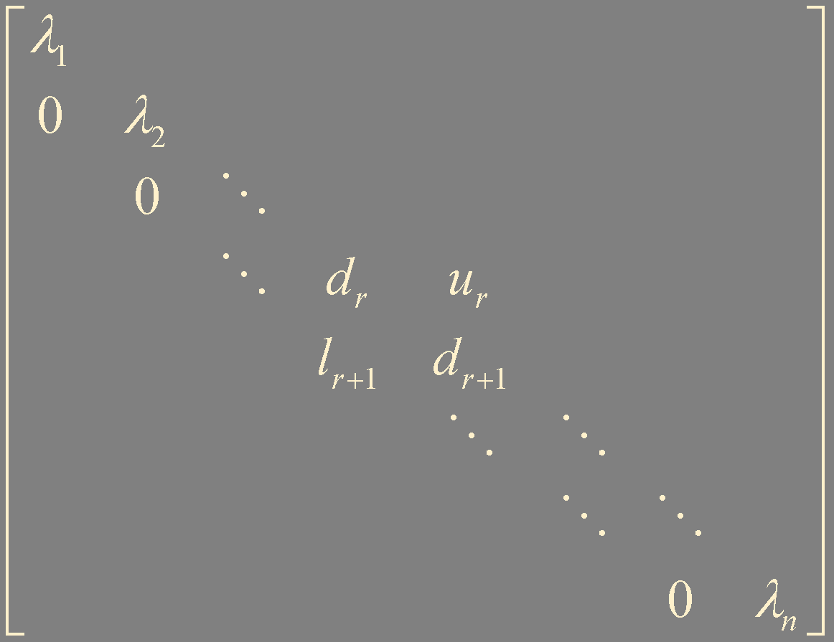
QR Algorithm on Hessenberg
A = Q₁R₁
A₁ = R₁Q₁
A₁ = Q₂R₂
A₂ = R₂Q₂
⋯
Hessenberg form 유지 !
Hessenberg form 유지 !
2×2 block의 characteristic equations의 solution이 eigenvalues
무한히 (충분히) 반복이 진행되면 A_{k}는 다음과 같은 형태로 수렴
(reduced Hessenberg form)
diagonal의 최대 block은 2×2 나머지는 real eigenvalues

Slide 14
Anatomy of QR Algorithm
Symmetric / Hermitian?
N
Y
reduction to tridiagonal
balancing
Householder
reduction to upper Hessenberg
Householder
QR algorithm on tridiagonal form
QR algorithm on Hessenberg form
QR decomposition
Householder / Givens
QR decomposition
Householder / Givens

Slide 15
Summary
QR algorithm 개론
Householder reduction
Hessenberg

